Slide 1
Research Support Office
Avdelningen för forskningsstöd
Stockholm Resilience Centre
Mikko Roos
mikko.roos@su.se
March 10, 2020

Slide 2
Research Support Office – our mission
Contribute to increased external research funding
Coordinate support to internationalization
Give support on matters concerning research ethics
More about us: www.su.se/forskningsstod

Slide 3
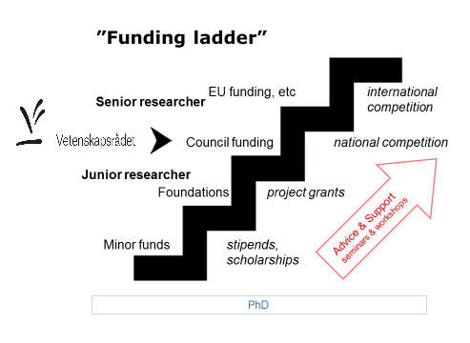

Slide 4
The Research Support Office and VR
Individual grants vs ”organization grants”
Organization grants: visiting professorships, scientific journal grants, infrastructure of national importance, doctoral programs (forskarskolor)
Support for individual researchers: Prisma support, successful applications on demand, budget support (limited!)
VR: national coordination of Open Research Data and ”NCP” for ERC
Contact person: Mikko Roos (also for Open Data and ERC StG & SyG)

Slide 5
VR project grants – general remarks
basic research
max. 4 years, max. 1 500 000 SEK/year
”safe”, incremental research OK, (cf. ”high risk, high gain” in ERC)
Officially a positive attitude toward interdisciplinary research – but no interdisciplinary panels
Grant approved? Time to write a DMP!
Review of applications
International panels, sometimes also remote referees, names of panel members available at www.vr.se
Assessment criteria: scientific quality, novelty & originality, feasibility, merits of the applicant
Proportionate to applicants’ career stage
https://www.vr.se/english/applying-for-funding/how-applications-are-assessed/peer-review-handbooks.html

Slide 6
Thank you!

