Slide 1

VR
- status and insights for SRC

Slide 2
Approved grants from VR
Name of grant |  | Year |  | Title
Forskningsbidrag Stora utlysningen 2018 (Humaniora och samhällsvetenskap) | 5 000 000 | 2018 | Deutsch Lisa | The Miracle Bean: Agrofood globalization through the lens of the soybean
Forskningsbidrag Stora utlysningen 2016 (Naturvetenskap och teknikvetenskap) | 3 000 000 | 2016 | Bodin Örjan | Is collaborative natural resource management improving ecological status, and if so, how?
Forskningsbidrag Stora utlysningen 2015 (Utvecklingsforskning) | 3 600 000 | 2015 | Tengö Maria | Connecting diverse knowledge systems at multiple scales for enhanced ecosystem governance - developing the Multiple Evidence Base approach
Bidrag till forskningsmiljö Tvärvetenskap 2018 (Vetenskapsrådet) | 18 110 000 | 2018 | Schlüter Maja | Approaches to causation in the social and natural sciences and their implications for theory building in sustainability science
Internationell utlysning för inbjudna: Projektbidrag Gender-net plus 2018 | 4 106 073 | 2018 | Wong Grace | SEQUAL: Social-ecological relations and gender equality: Dynamics and processes for transformational change across scales.
Projektbidrag Sustainability and resilience | 5 629 230 | 2018 | Lindkvist Emilie | Navigating the complexity of small-scale fishery interventions: An intersection of agent-based modeling and participatory empirical research
Projektbidrag Sustainability and resilience | 5 483 982 | 2018 | Mancilla Garcia Maria | Forum theatre to enhance joint agency in Kenya and Mozambique: towards relational understandings of climate change
Internationell postdok 1 2019 (Vetenskapsrådet) | 3 150 000 | 2019 | Enqvist Johan | Drought as a leverage point for urban climate adaptation: How and for how long will Cape Town’s water crisis influence residents’…
Internationell postdok 2 2018 | 3 150 000 | 2018 | Haider L. Jamila | Development as coevolution: How can resilience inform sustainable development in biocultural landscapes?
Internationell postdok 1 2017 | 3 150 000 | 2017 | West Simon | Interpreting the practice of ecosystem services: Indigenous and scientific experiences from Northern Australia
Internationell postdok 2 2017 | 3 150 000 | 2017 | Masterson Vanessa | Cultural and relational values in rural-urban migration - implications for migrant wellbeing and environmental governance in Sub-Saharan Africa
Projektbidrag - Unga forskare |  | 2014 | Biggs Reinette | Regime Shifts in the Anthropocene: Assessing risks and building resilience
U-forsk, Utlysning avseende 2012 års ansökningar |  | 2013 | Crona Beatrice | Ansökan: SWE-2012-104: Middlemen in the seafood trading chain: a critical link for achieving sustainable small-scale fisheries
+ Earlier e.g.: Ryan Plummer, VR 2012 (€490,000): Diagnosing processes and outcomes in social-ecological systems: A systematic, cross-case comparison of adaptive co-management initiatives
Andreas Duit, VR 2011 (€840,000): Stakeholder participation, learning and management of ecosystems: a global study of 146 Biosphere Reserves in 55 countries

Slide 3
Approved and rejected

Slide 4
Approval rates
 | Approval rate VR | Approval rate Formas | Approval rate VR and Formas, total | Number of approved VR and Formas grants | Sum approved, total (SEK)
2019 | 6% | 33% | 25% | 14 approved | 45 707 379
2018 | 19% | 19% with EU-call (13% without EU-call) | 19% | 14 approved | 66 000 000
2017 | 13% | 17% | 16% | 8 approved | 27 300 000
2016 | 6% | 36% | 24% | 10 approved | 24 800 000
For comparison:
The approval rates in total for VR: 17% 2018 and 18% 2017.
The approval rates in total for Formas annual open calls: 16,7% 2019, 17,8% 2018 and 17,1% 2017.
In addition:
VR is considered a high quality indicator grant by SU

Slide 5
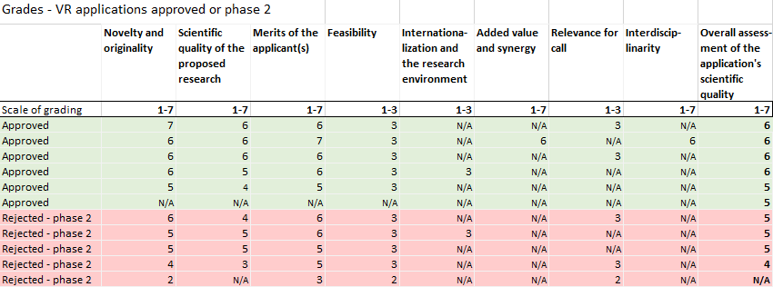
SRC

Slide 6
What do our colleagues say?
Ranges from: - I was a bit surprised I didn’t get it.
To: - The application was pretty bad and I basically had no idea what I was doing.
Common thoughts among colleagues regarding rejection reasons
Too out of the ordinary
They don’t understand transdisciplinary
They thought it was too vague
- Over the years I have submitted numerous proposals. Most of the times I don't have a clue why they get rated as they do.
- It is difficult to draw any major conclusions of these decisions. Depending on the composition of the group, different things are weighted up or down.

Slide 7
SRC mentions
At SRC the team also has access to other experienced researchers in this field of study (VR)
The track record of the host institute is very good (Formas)
Host institute has good reputation and provide a good research environment (Formas)
Please note: there wasn’t enough data to draw tendency conclusions for the different kinds of VR panels (natural science/social science/development panels).

Slide 8
Strong
VR’s and Formas’ review feedback about what makes an application strong
Research question is of clear relevance / Asks important and relevant questions.
Clear description of the problem area.
The proposal is well-written. The proposal is fairly devoid of jargon, buzz words and repetitions. (VR)
Methods are well described / State-of-the-art methods.
Team of competent researchers. / Strong local partners.
Merits of the applicant(s): outstanding (grade 7 of 7)
Shed new light to an important and ongoing debate. The proposal introduces a fresh air of thinking.
Building on previous research.

Slide 9
Weak
VR’s and Formas’ review feedback about what makes an application weak
Methodology concerns
The wide number of perspectives makes the project’s exact focus unclear.
Few methodological details are provided and the rationale for these.
Not convinced that the suggested methodology will contribute significant.
Vagueness in the methodology regarding the collection of data.
Theory concerns
Theory setting is addressed only on a superficial level; it should have described the knowledge gaps it intends to fill.
The fitting together of the theoretical framework and the fieldwork is not fully clear.
Staffing concerns
Concern that the not-identified postdocs are allocated the roles as WP leaders.
Not completely clear what the two senior scholars can contribute with such a limited involvement in the project.
Value
Its delivery is shadowed by questions about whether the proposal can substantially advance the existing knowledge.

Slide 10
3 things to consider
1)
If you are suggesting to use more than one method, don’t forget to write the rationale behind your selection of methods. VR and Formas seem to be looking for a clear logic of how methods tie together, and strengthen each other. If the methods are only described in isolation, they might grade the overall method as unclear. (Especially if they are handling both disciplinary and trans-/interdisciplinary proposals.)

Slide 11
3 things to consider
2)
Be explicit about how the proposal can advance existing knowledge. If you view it as a potential frontier, explain why. (Some panels seem to value clear bullet points).

Slide 12
3 things to consider
3)
Some SRC colleagues have felt misunderstood when it comes to the communication grade they got. Some panels might need support to think deeper and broader when it comes to communication. E.g. about how co-production and transdisciplinary connects to communication, or how the thoughtful selection of partners might be connected to dealing with real practice, or how the carefully designed process can accelerate science-based action for sustainability, or how “samverkan” can shorten the implementation-time, or how “samverkan” can make results more context-relevant and ready to implement, or how “samverkan” can include identified change makers from the beginning of a change process.

Slide 13
Additional potentials
Proactive steps
Have staff from SRC as members of the review panels of Formas and VR
Strategic arrangements
Share information among all SRC staff about upcoming calls and alternative funding
Strategically facilitate for people to cooperate synergised within SRCs vision
Peer supporting
Internal review processes and feedback groups across applications
Share experiences and arrange discussion groups among staff
Application styling
Start preparing and writing the proposal well in time. Avoid vagueness. If you can't be specific, explain why you can't be specific (e.g. CAS dynamics).
Current trends among others?: hire an application pro writer

